Slide 1



Application Programming Interface (API)
An API is a software intermediary that allows two or more applications to talk to each other.
API Type in terms of Release Policies:-
Private – It can be used within the organization.
Partner – It can be used within Business Partners.
Public – It can be used any third party Developers.

Slide 2

Google Map API
Application
Provider
Google Map
Consumer

Slide 3
Flipkart API
JioMart API
Provider
Provider
Website
Consumer
Snapdeal API
Amazon API
Provider
Provider

Slide 4
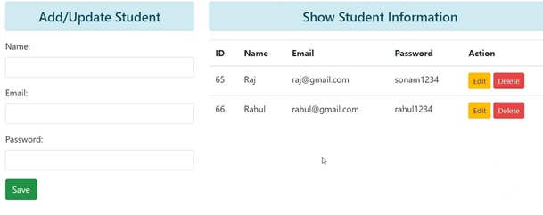
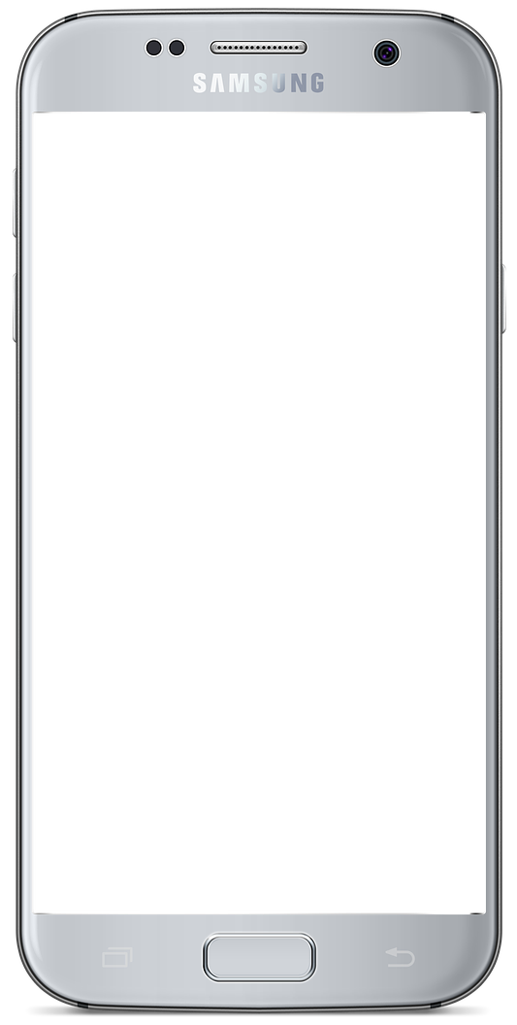

Application
Database

Slide 5
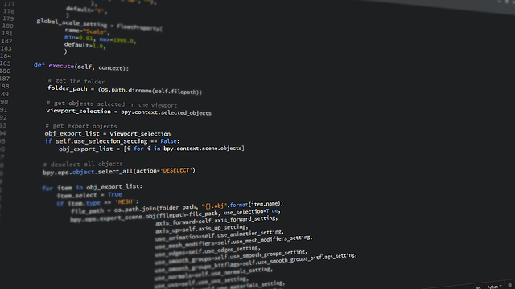
API
Web Application
Database

Slide 6
How use API
API
Application
Database
API Key/Token: 23423jkhjhgh32434hjgjh4343

Slide 7
Web API
An API, which is interface for web is called as Web API.
It may consist of one or more endpoints to define request and response.

Slide 8
How Web API Works
Web API
Web Application
Database
Client makes HTTP Request to API
API will communicate to Web Application/Database (If needed)
Web Application/Database provides required data to API
API returns Data to Client
Note – Json Data, XML Data

Slide 9
How to use Web API
API
Web Application
Database
Register/Sign-up to API
API may provide API Key for Authentication purpose
API Key/Token: 23423jkhjhgh32434hjgjh4343
Whenever you need to communicate with server make Request to API with API Key
http://geekyshows.com/?key=23423jkhjhgh32434hjgjh4343
If API Key authentication succeed, API will provide required Data

